Slide 1
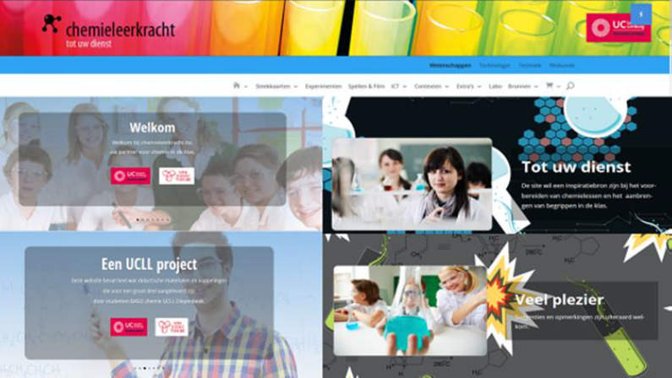
Methode9:GO-LAB

Slide 2
Methode9: GO-lab
KLIK

Slide 3
twenteIlsPlayer: Waterstofbruggen - Detective

