Slide 1
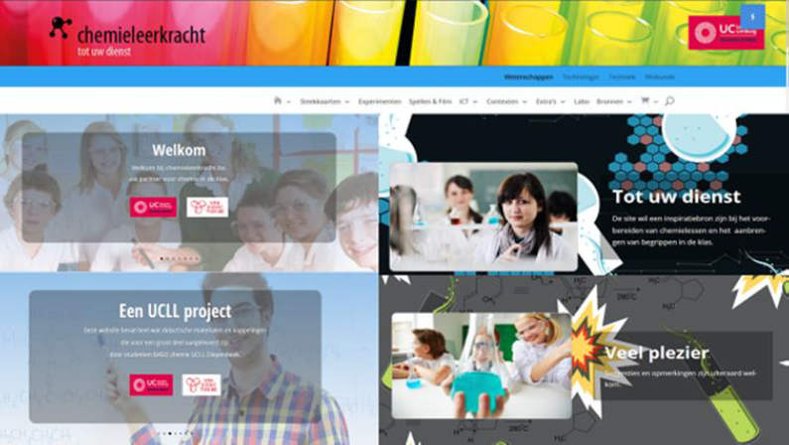
Methode6: Talbica
LINK

Slide 2
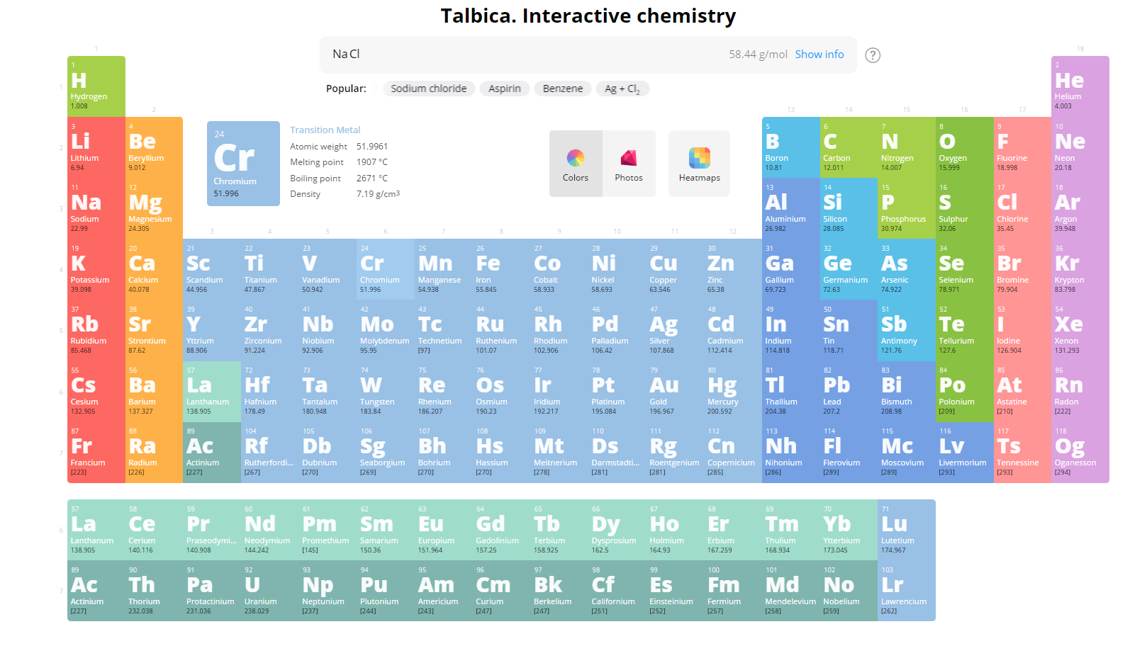
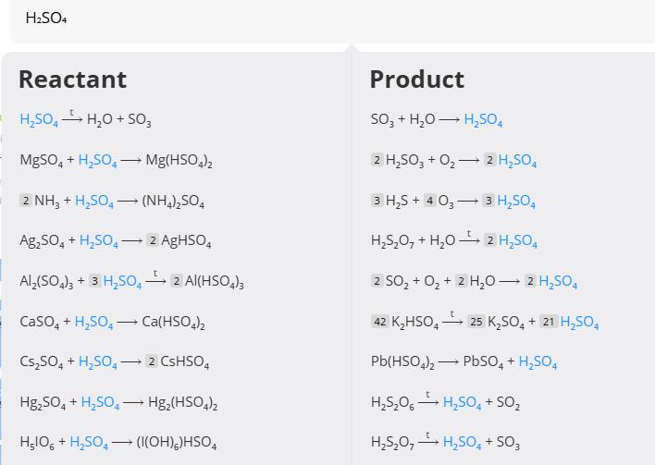
Talbica: interactive chemistry
Talbica 3: Periodic Table and Chemical Reactions Database

