Slide 1
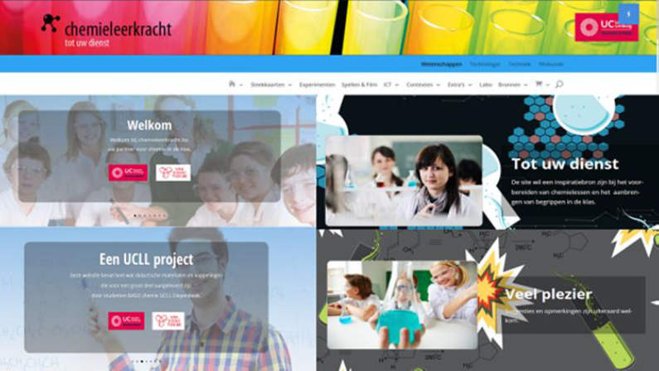
Methode6:Galvanische cellen met Kappenberg

Slide 2
Methode6: Halfcellen Kappenberg
KLIK - KLIK

Slide 4
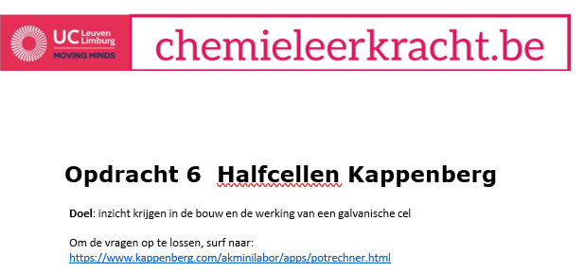
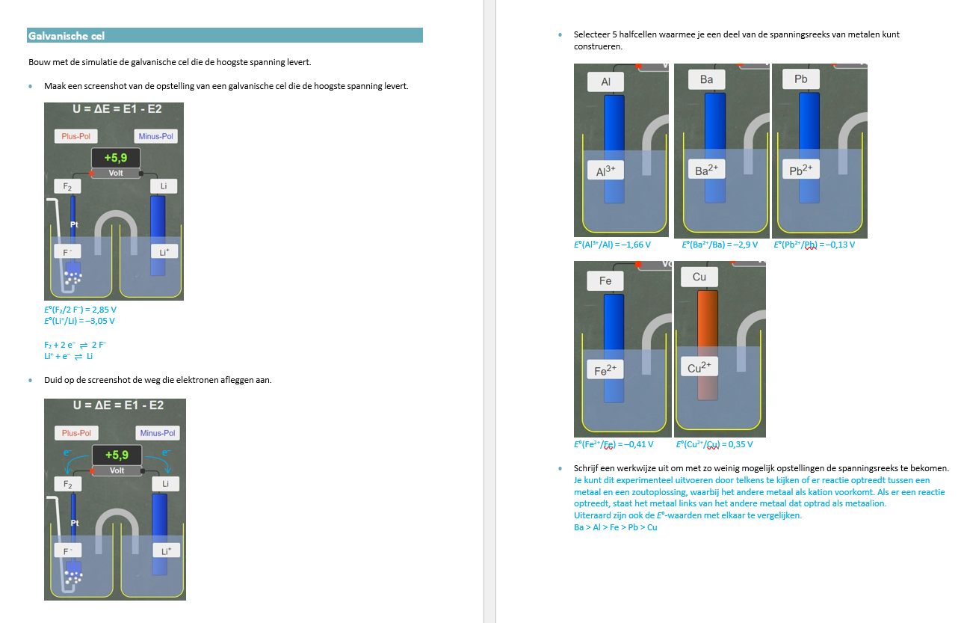
https://www.kappenberg.com/akminilabor/apps/potrechner.html

