Slide 1
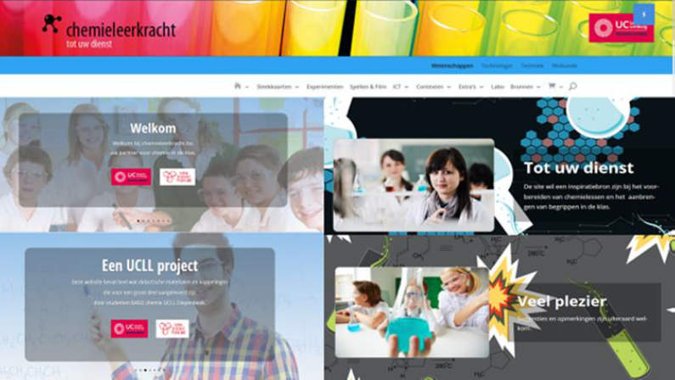
Methode6:Sciencephoto + Wolfram

Slide 2
Methode6: Animaties
KLIK

Slide 3
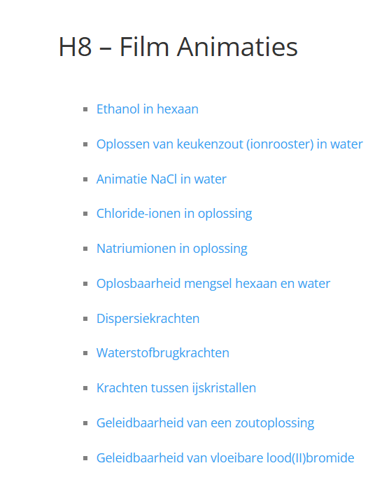
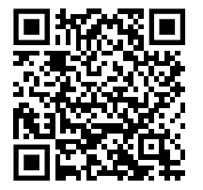

Slide 4
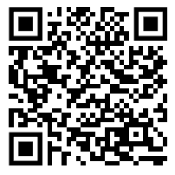
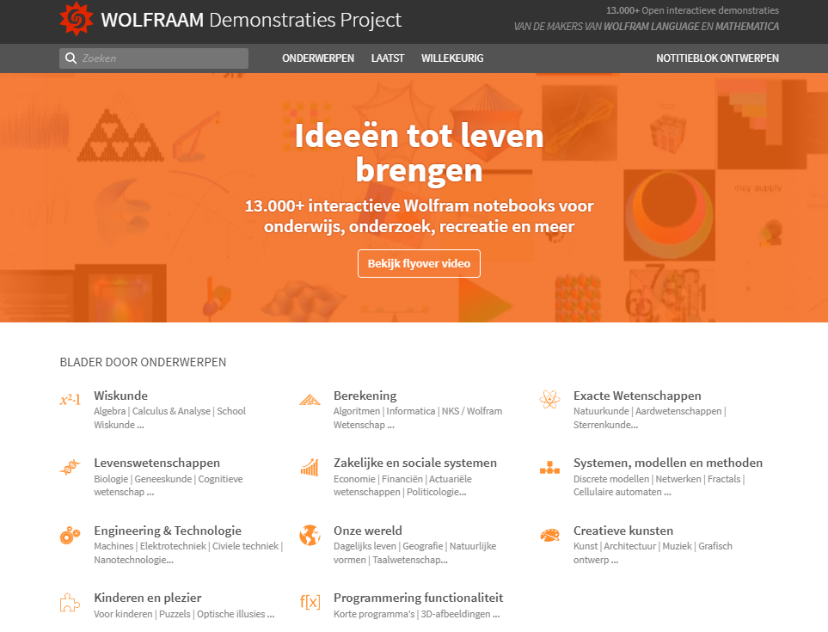
Physical Sciences Topics | Wolfram Demonstrations Project

