Slide 1
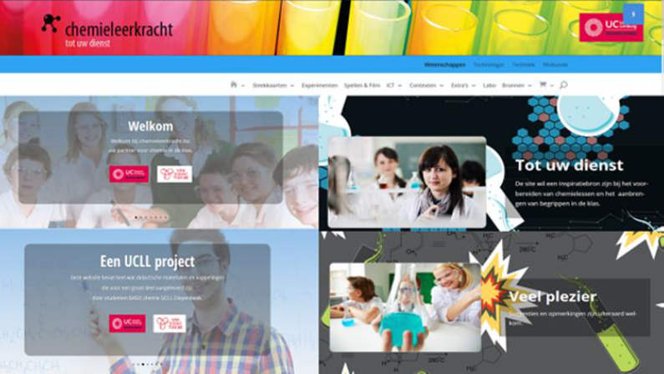
Methode5:Libretext

Slide 2
Methode5: Libretext
KLIK
Home - Scheikunde LibreTeksten

Slide 3
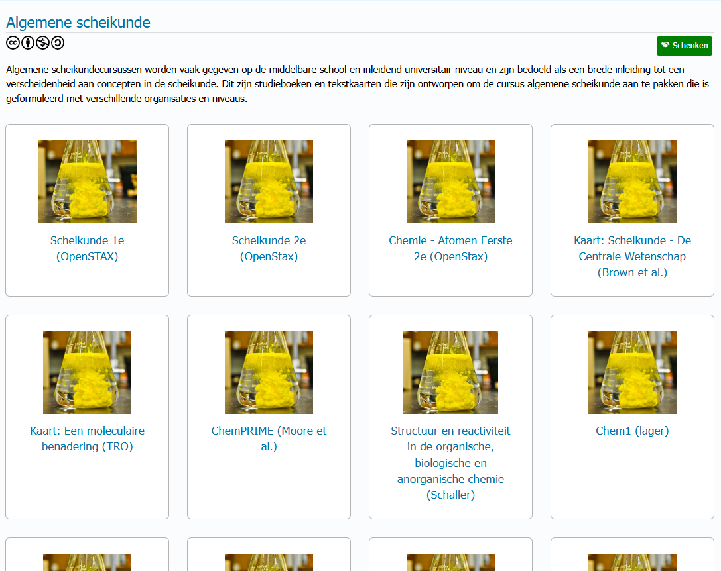
Algemene Scheikunde - Scheikunde LibreTexts

Slide 4
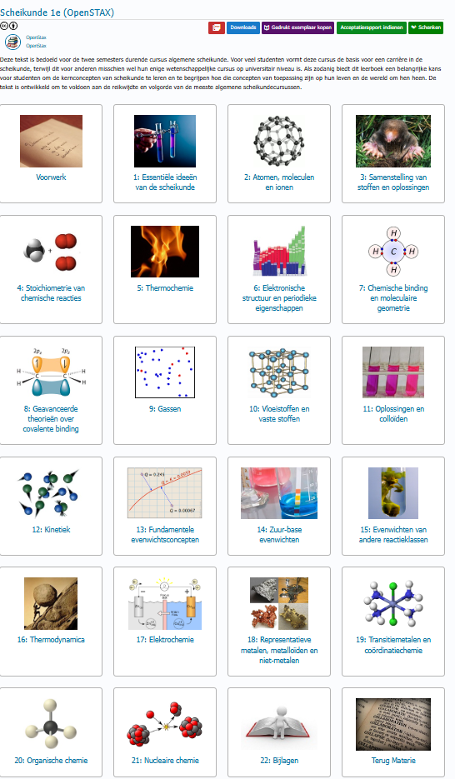
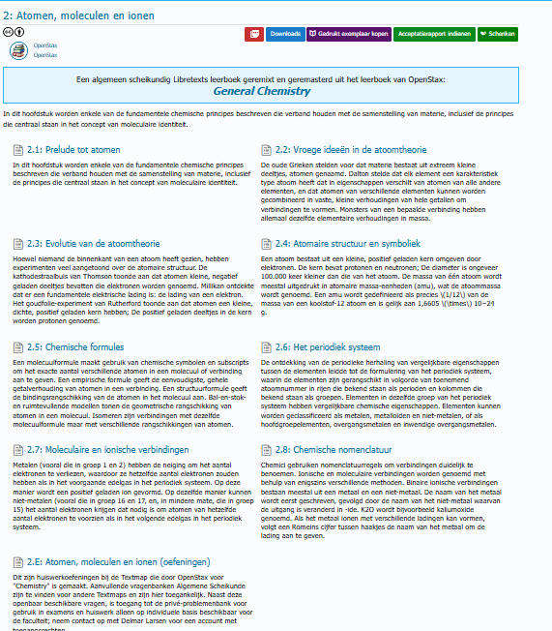

Slide 5
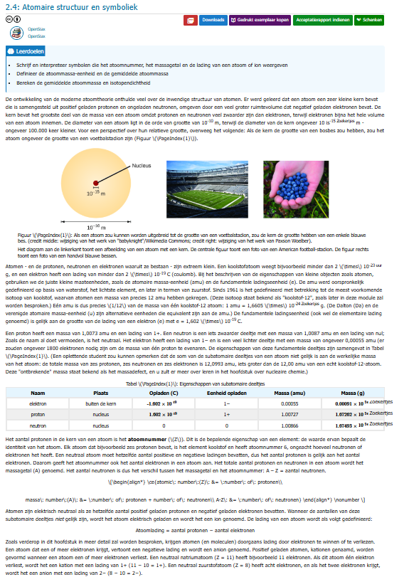

Slide 6
Bron; 7.2: Intermoleculaire krachten - Chemie LibreTexts

