Slide 1
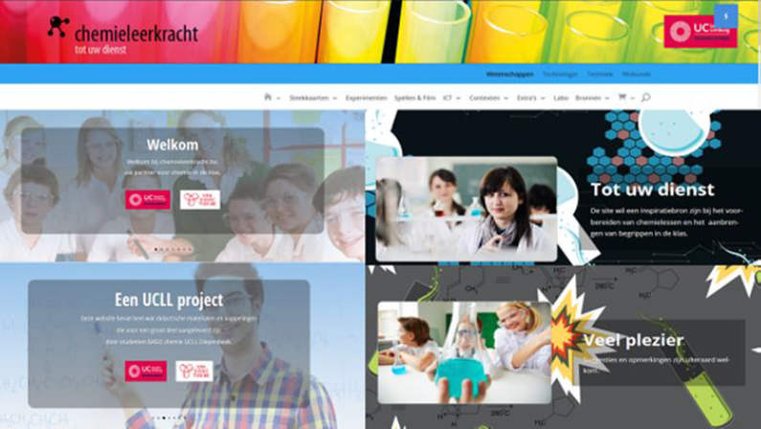
Methode4: Istock
LINK

Slide 2
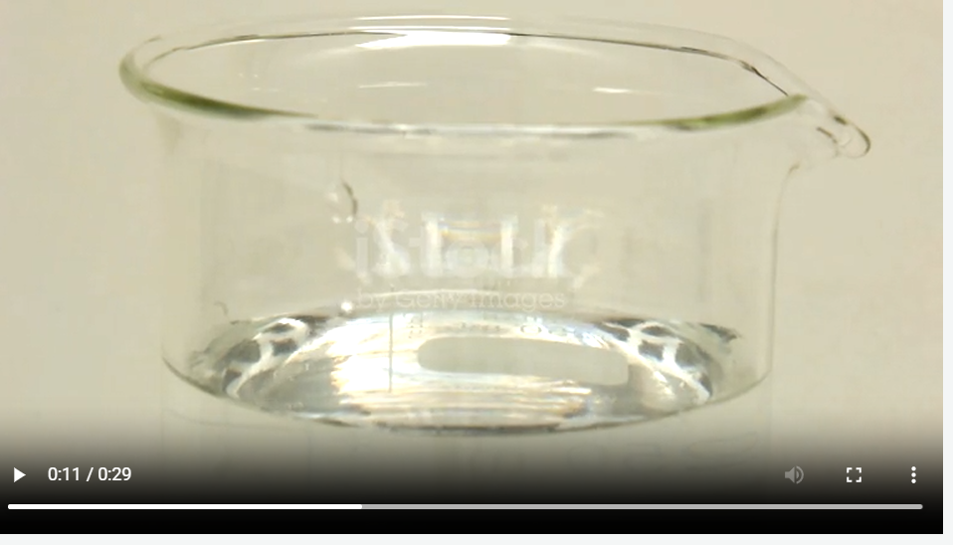
Stockvideo's en rechtenvrije video's, 4K + HD - iStock

