Slide 1
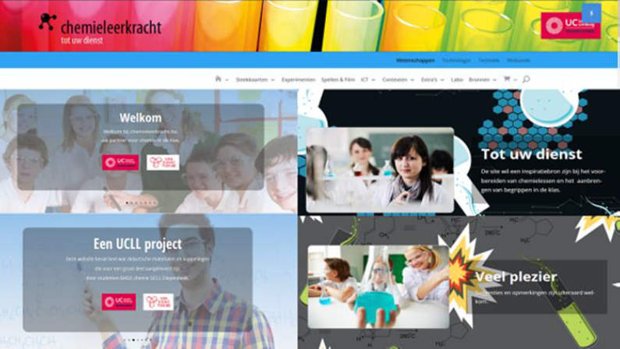
Methode2:App pH scale and -meter

Slide 2
Methode2: pH scale and -meter
KLIK

Slide 3
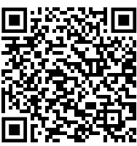
Virtual Labs: pH Scale and Meter Calibration on the App Store

Slide 4
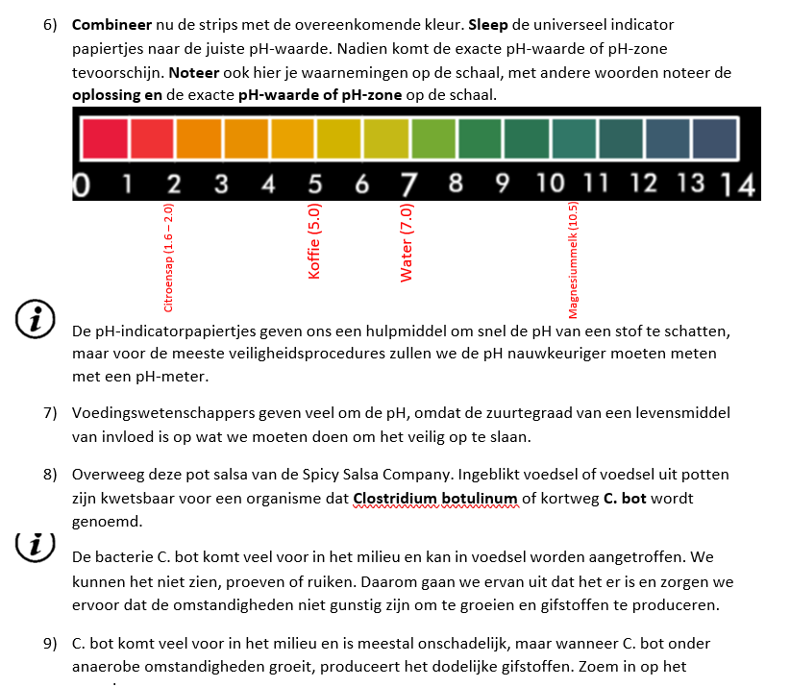

Slide 5
Methode3:Filmfragment en bookwidgets

