Slide 1
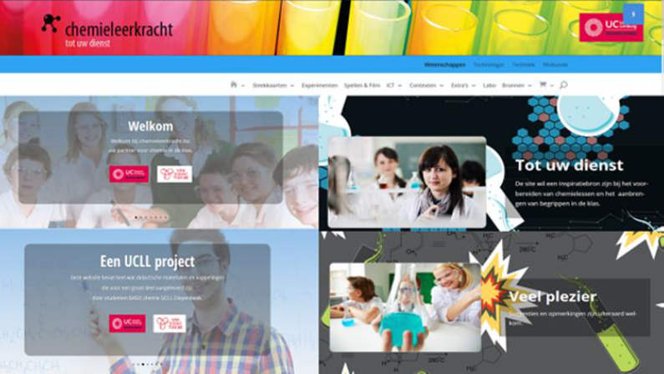
Methode14: Posters
LINK

Slide 2
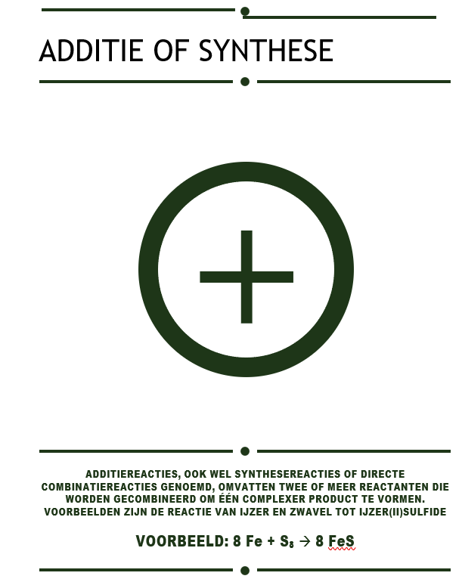
Compound Interest: Chemistry infographics

