Slide 1
Methode14:Spellen

Slide 2
Methode14: Bordspellen
KLIK - KLIK - KLIK - KLIK - KLIK

Slide 3
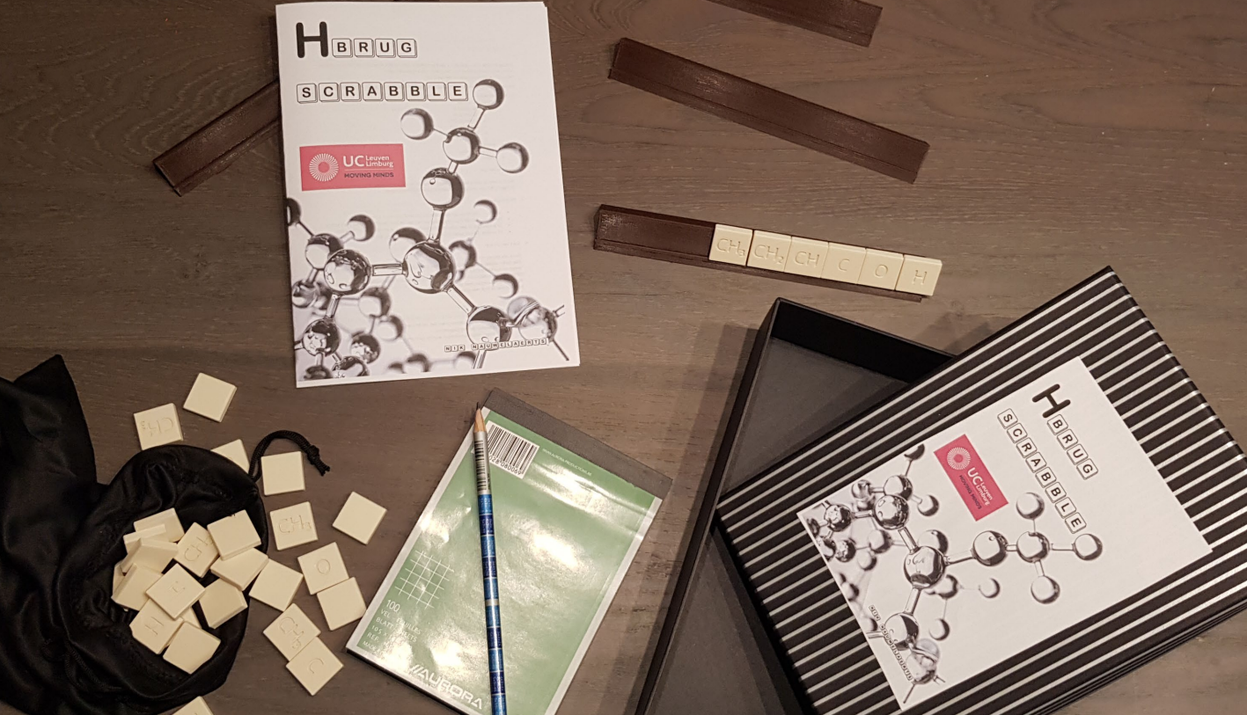

Slide 4
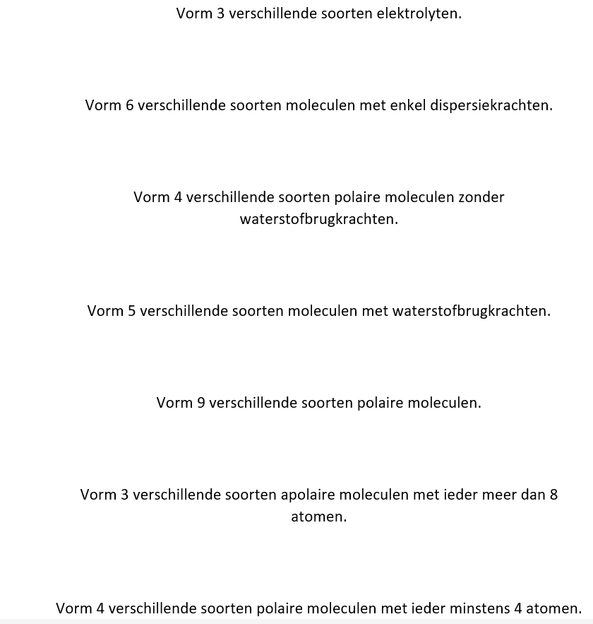
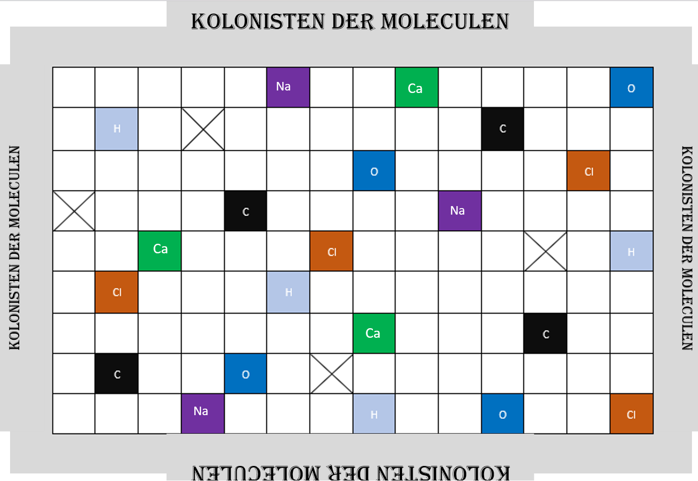

Slide 6
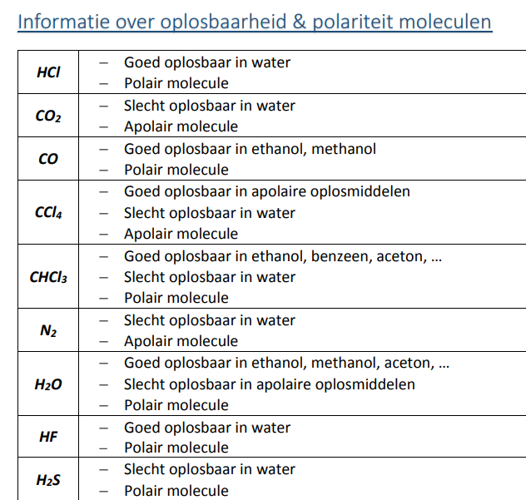

Slide 7
https://www.bookwidgets.com/play/9ZCnbuDs-iQAFBiVXTgAAA/TGPSJTU/wie-is-het-int?teacher_id=6268783509372928

Slide 8
