Slide 1
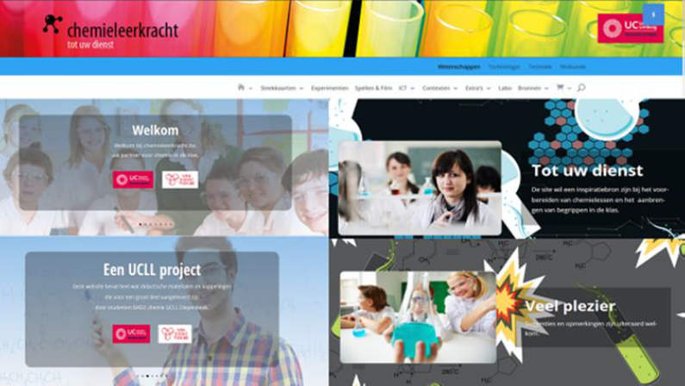
Methode11:old IUPAC - didac

Slide 2
Methode11: IUPAC
KLIK

