Slide 1
Reacties tussen anorganische stofklassen
19
M nM
2
MZ
MO 10 nMO
1
1
MOH 26 HZ
4
3
21
7
1
8
20
11
5
6
22
16
13
23
24
25
12
9
14
18
15
17

Slide 2
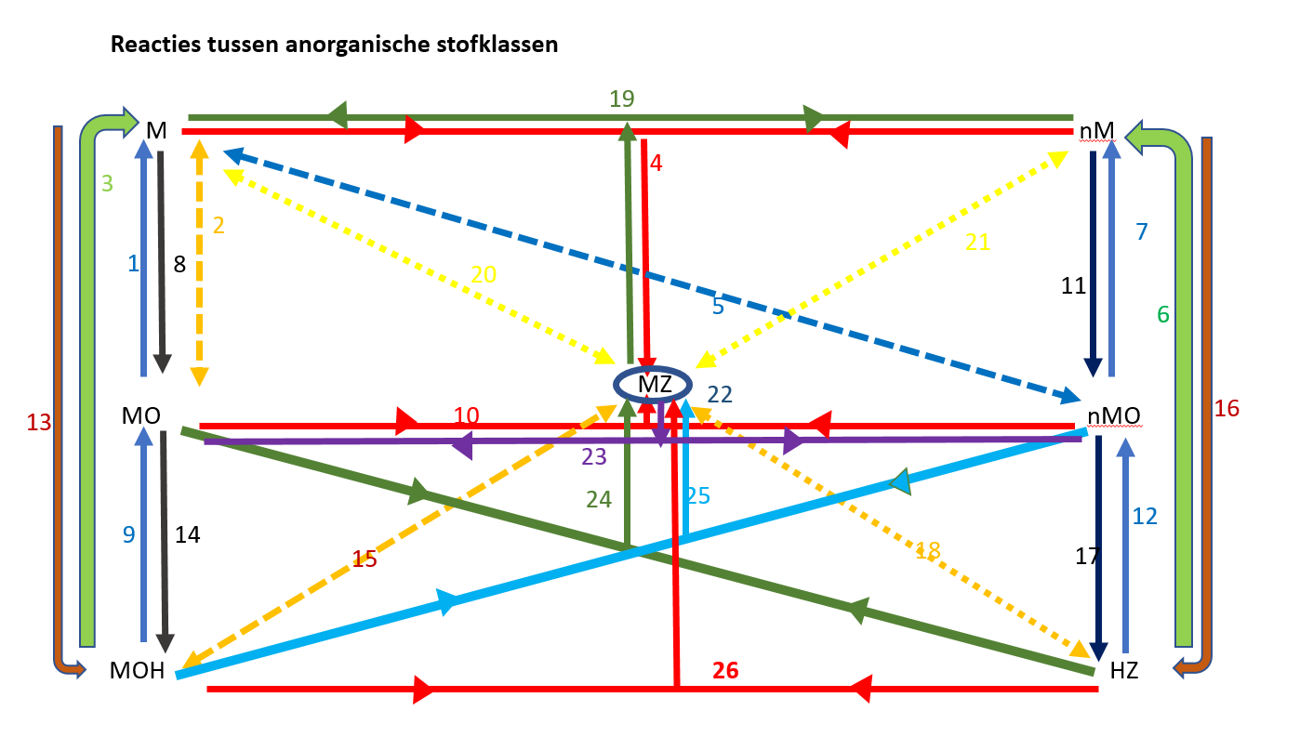
REACTIE | Nr.
MO → M + O₂ | 1
M + M’O → M’ + MO | 2
MOH ---> M + O₂ + H₂O | 3
MZ ---> M + nM | 4
nMO + M’---> nM + M’O | 5
HZ→H₂ + nM | 6
nMO→nM+O2 | 7
M + O₂ --> MO | 8
MOH ---> MO + H₂O | 9
MZ ---> MO + nMO | 10
nM + O₂ ---> nMO | 11
HZ ---> nMO + H₂O | 12
M + H₂O → MOH + H₂ | 13
MO + H₂O ---> MOH | 14
MZ + M'OH ---> M'Z + MOH | 15
nM + H₂ ---> HZ | 16
nMO + H₂O ---> HZ | 17
MZ + HZ' ---> MZ' + HZ | 18
M + nM ---> MZ | 19
M + M'Z ---> MZ + M' | 20
nM + MZ ---> MZ' + nM' | 21
MZ + M’Z’ → MZ’ + M’Z | 22
MO + nMO ---> MZ | 23
MO + HZ ---> MZ + H₂O | 24
nMO + MOH ---> MZ + H₂O | 25
HZ + MOH → MZ + H₂O | 26
HZ + M → MZ + H₂ | 27

