Slide 1
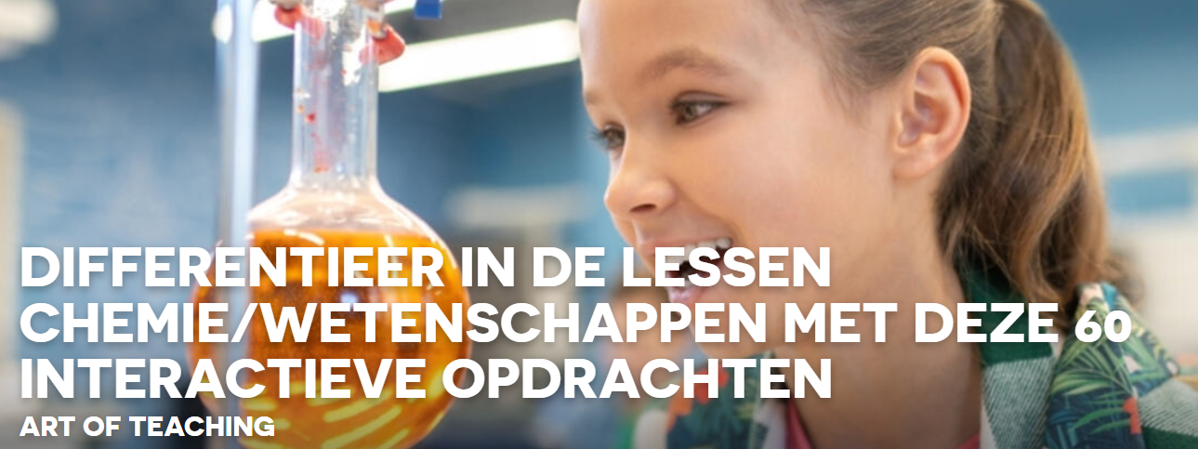
Virtual Lab op ipad: sven

Slide 2
Virtual labs via ipad www.ajaxmediatech.com - iPad (apple.com)
sunil christian - iPad & iPhone (apple.com)
Virtuele labs: pH-schaal en meterkalibratie in de App Store (apple.com)
Acid Base Titration (Simulator) : Inorganic Chemistry
virtueel lab: Acid Base Inquiry - Mr. Palermo's Flipped Chemistry Classroom (mrpalermo.com)

Slide 3
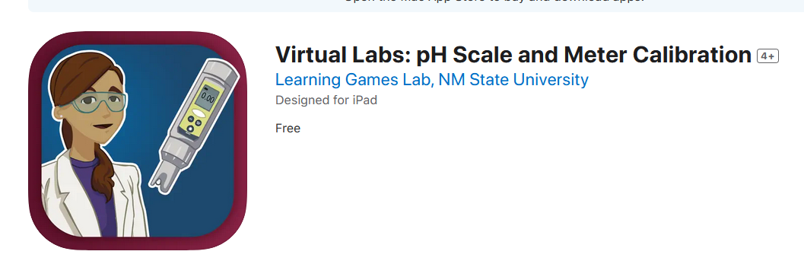
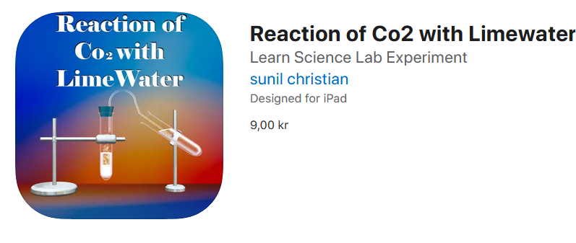
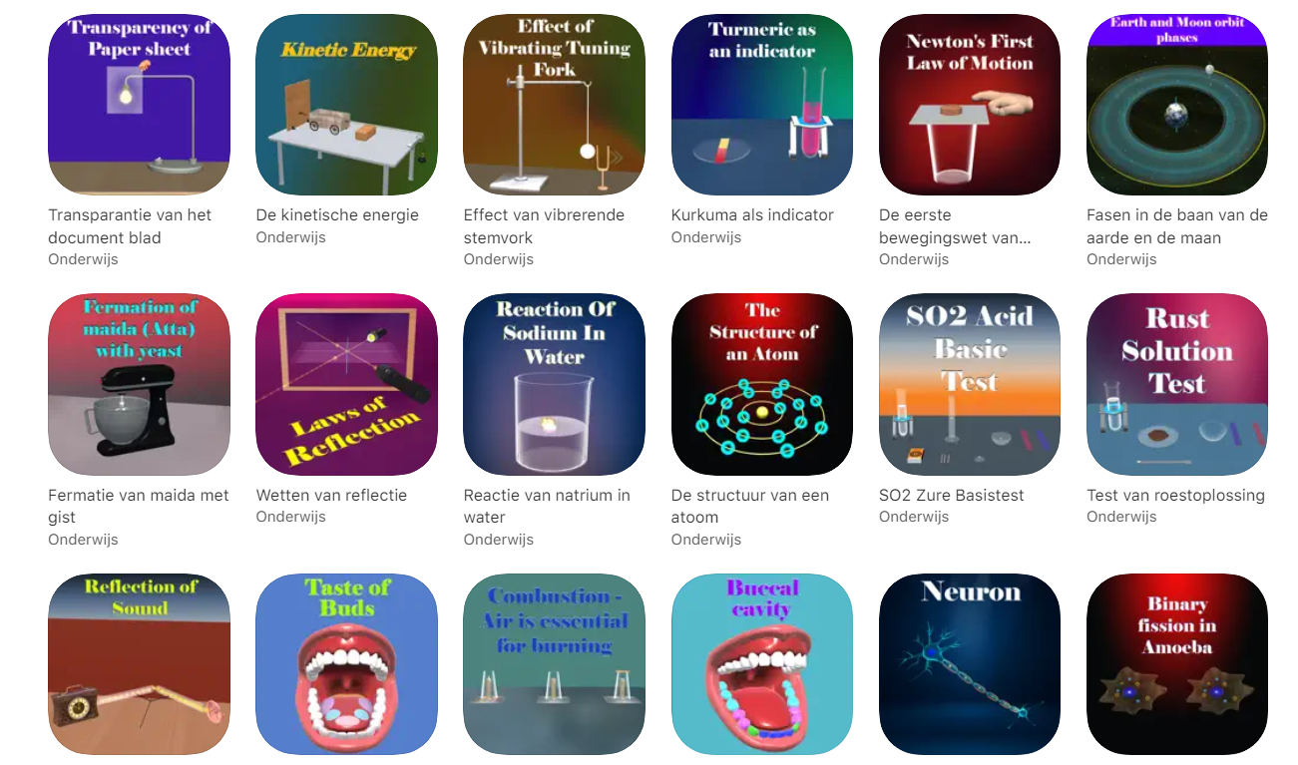
https://apps.apple.com/us/app/virtual-labs-ph-scale-and-meter-calibration/id1095437292
https://apps.apple.com/dk/developer/sunil-christian/id1474217212?see-all=i-phonei-pad-apps

Slide 4

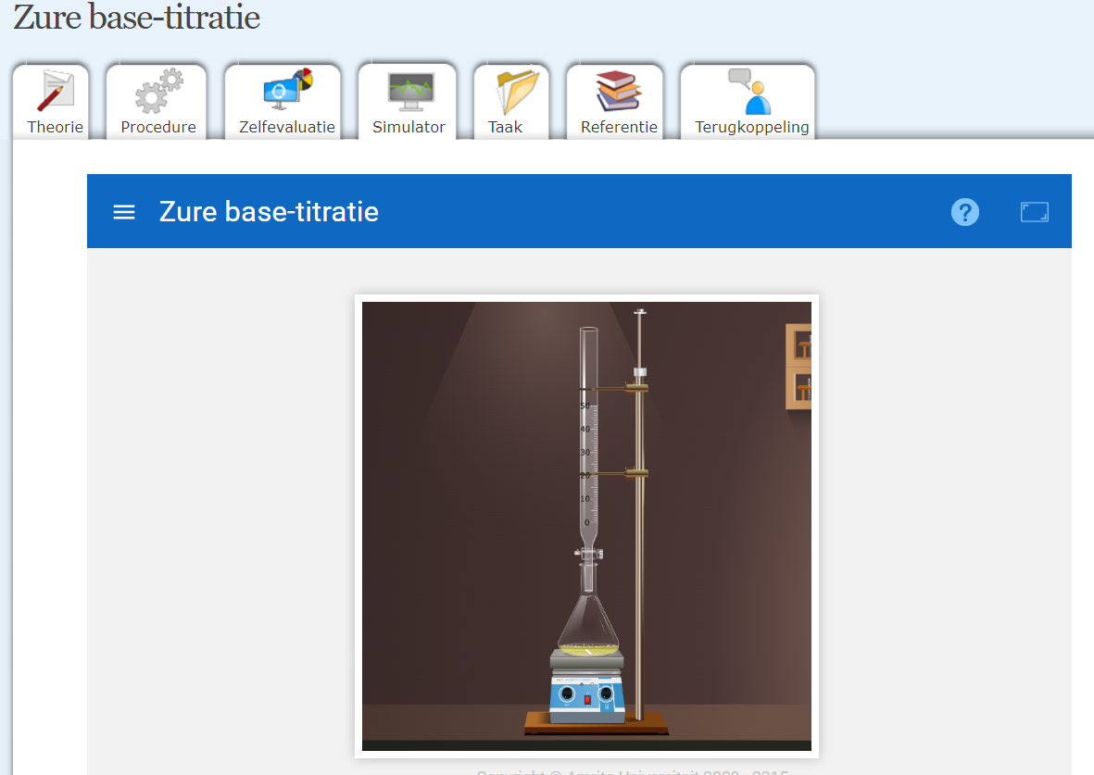
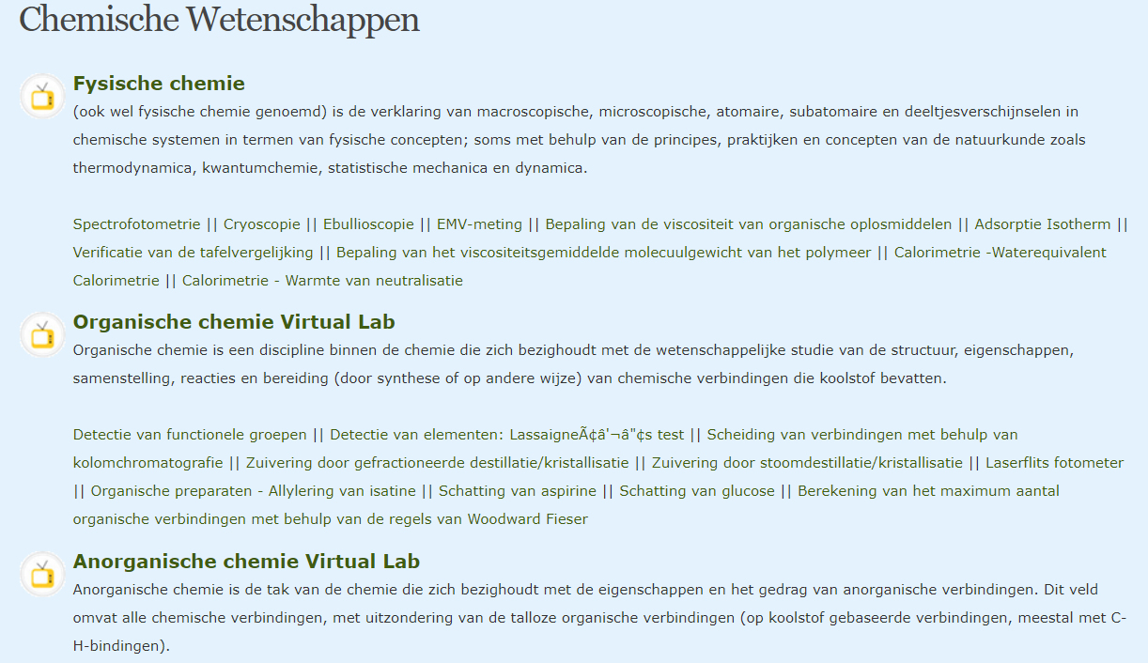
Chemical Sciences : Amrita Vishwa Vidyapeetham Virtual Lab

Slide 5
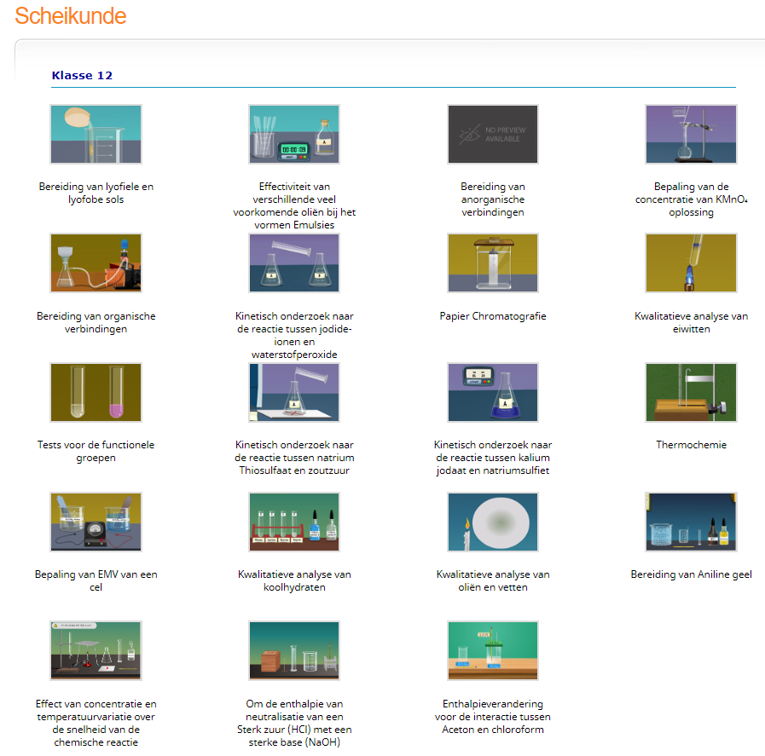
amrita.olabs.edu.in/?sub=73

Slide 6
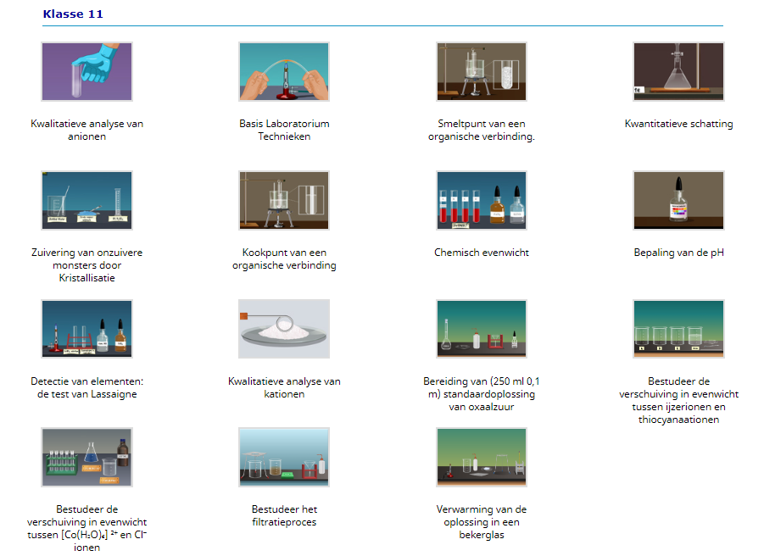

Slide 7
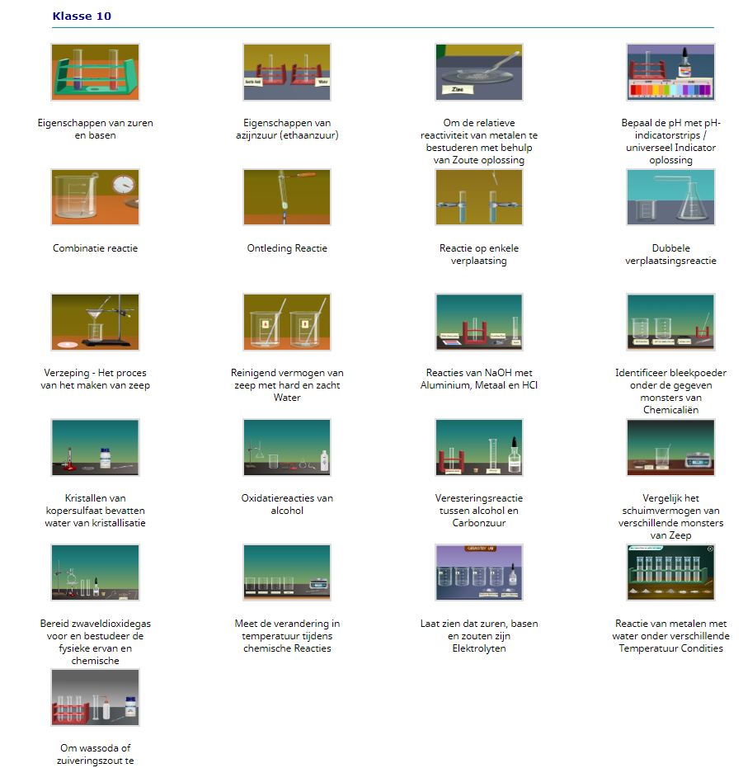

Slide 8
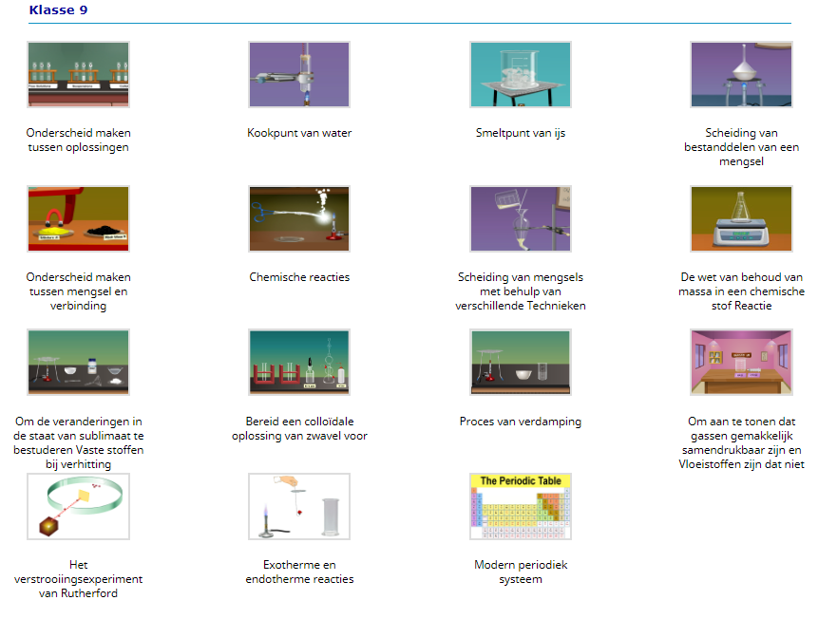

Slide 9
