Slide 1

Ipad apps: tekenen van organische structuren

Slide 2
Molecular Constructor - Apps op Google Play
iMolecular Builder voor iPad in de App Store (apple.com)
iMolecular Draw voor iPad in de App Store (apple.com)
KingDraw in de App Store (apple.com)
Molecule Lab in de App Store (apple.com)
KingDraw in de App Store (apple.com)
Molecule Lab in de App Store (apple.com)

Slide 3
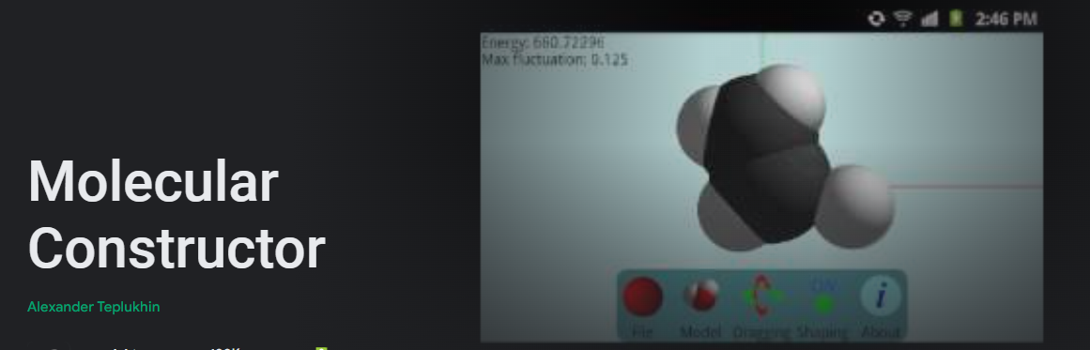
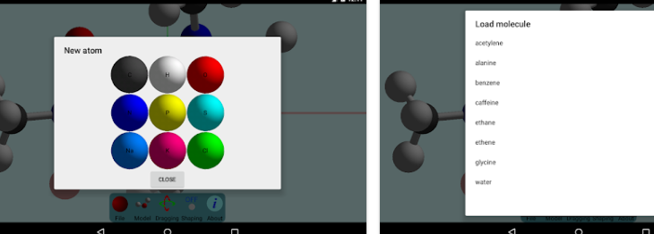
Molecular Constructor - Apps op Google Play

Slide 4
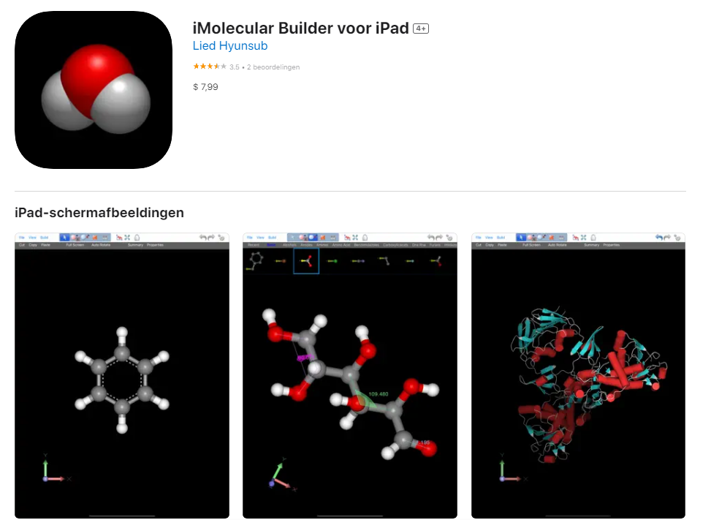
iMolecular Builder voor iPad in de App Store (apple.com)

Slide 5
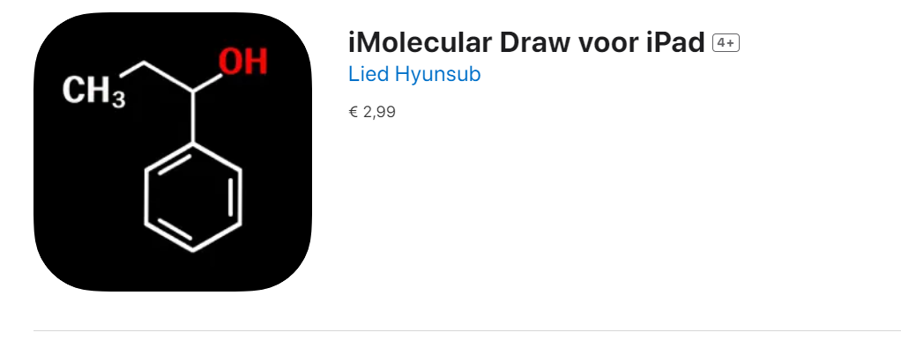
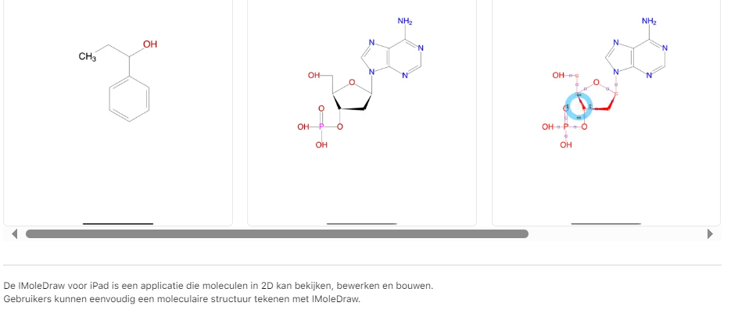
iMolecular Draw voor iPad in de App Store (apple.com)

Slide 6
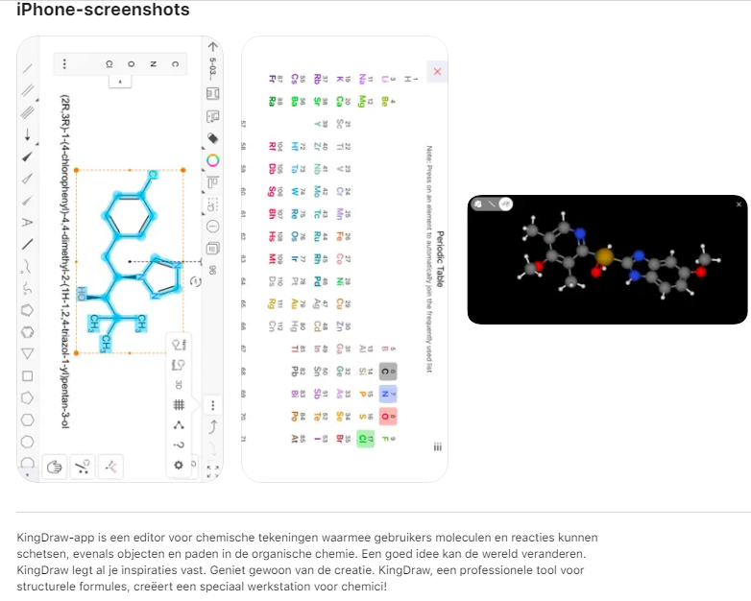
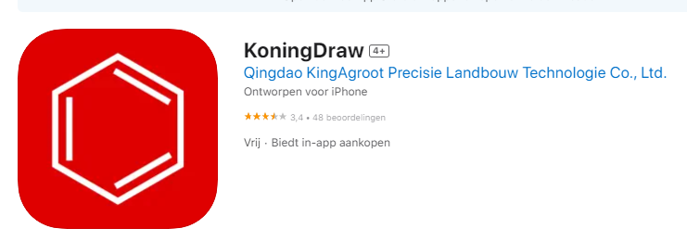
KingDraw in de App Store (apple.com)

Slide 7
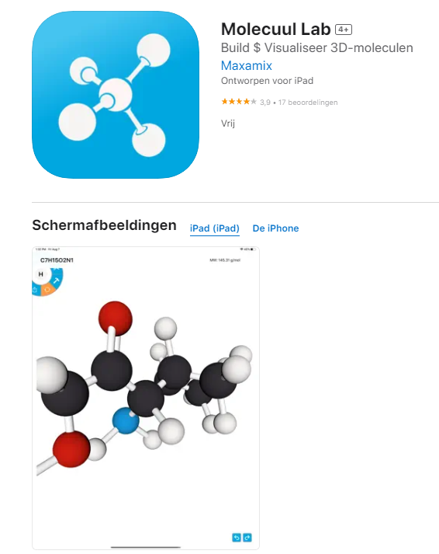
Molecule Lab in de App Store (apple.com)

