Slide 1
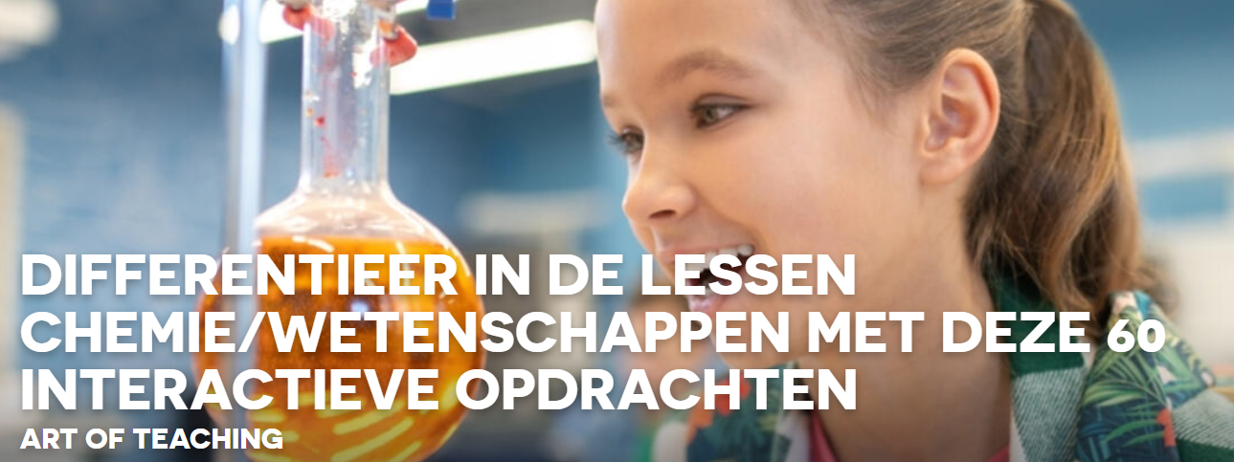
Gebruik van de simulaties op InteractiveChemistry https://interactivechemistry.org/
Anouchka, (OF 3)

Slide 2
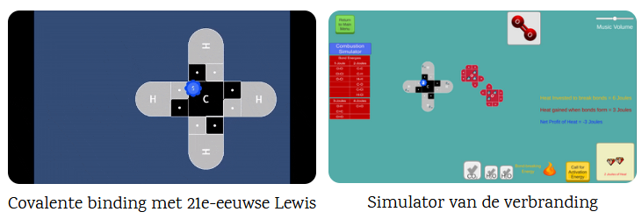
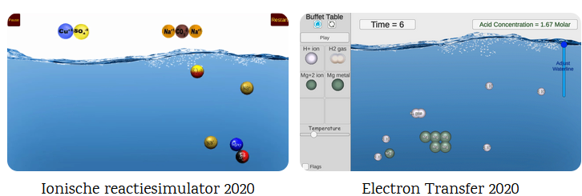
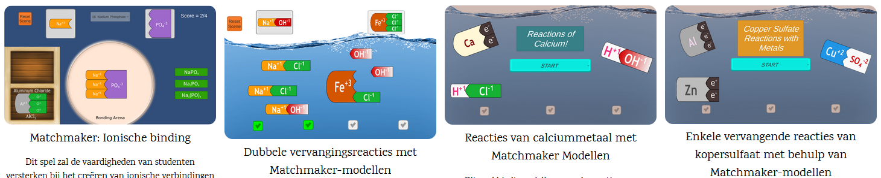
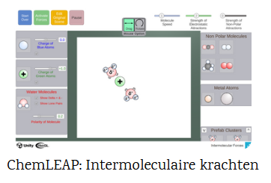
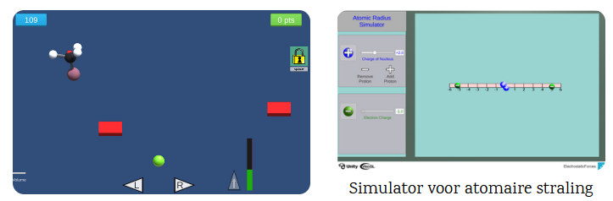
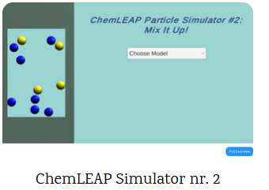

Slide 3
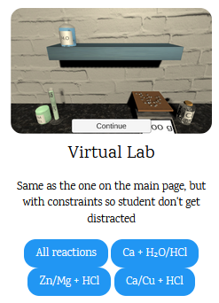
https://interactivechemistry.org/Experiments-Prototypes/

Slide 4
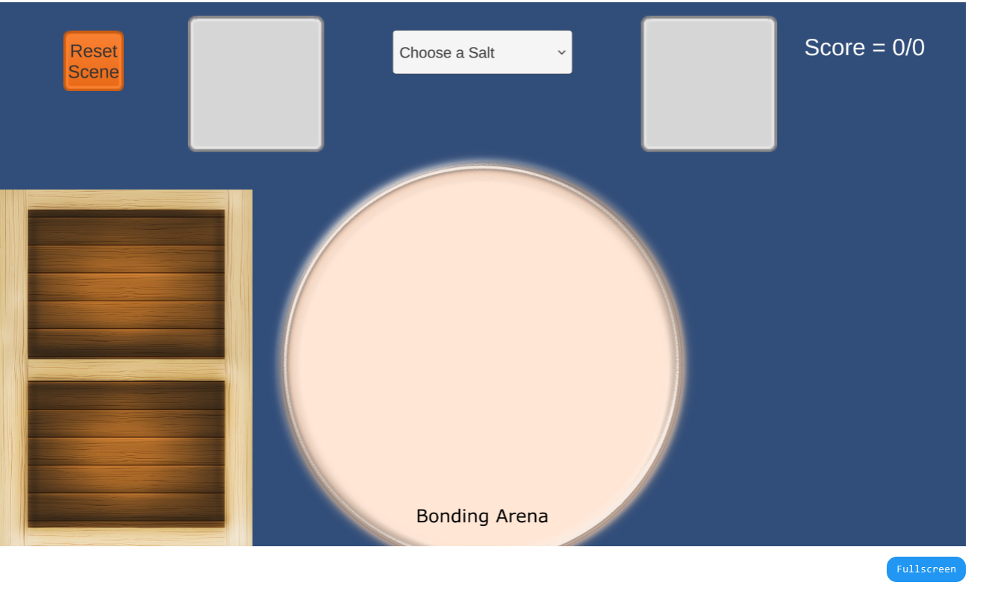
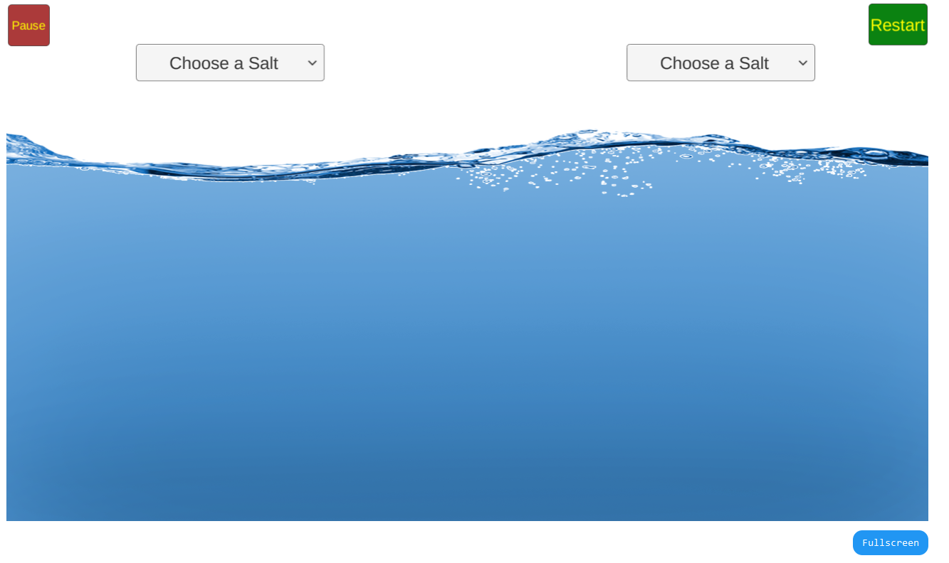
https://interactivechemistry.org/Matchmaker/
https://interactivechemistry.org/IonicReactions/
https://teachchemistry.org/classroom-resources/matchmaker-ionic-bonding-activity

