Slide 1
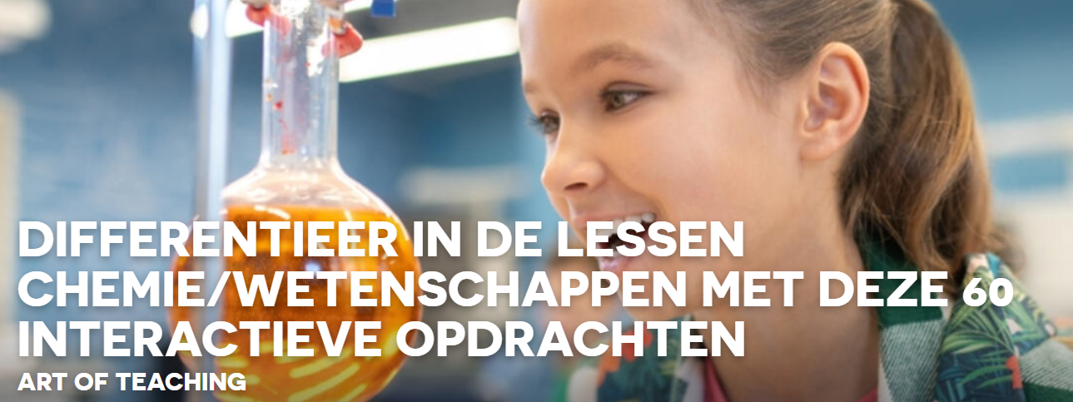
Chemagic : lies

Slide 2
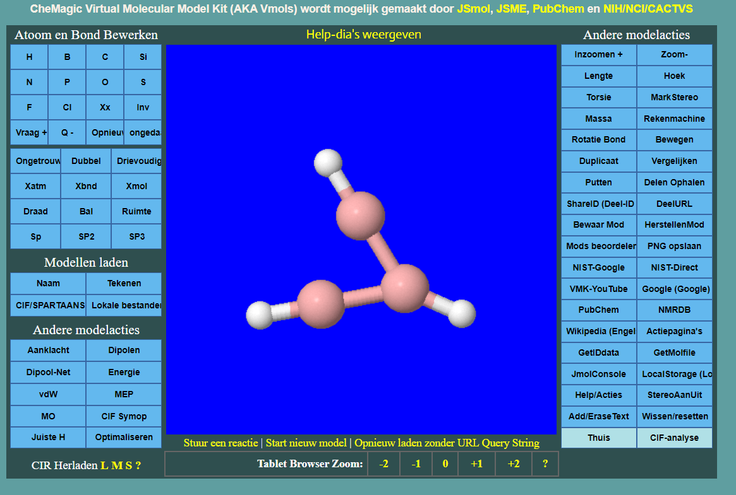
https://chemagic.org/molecules/amini.html# :
Model Kit Basic Operation Video 1: Building a New Model and Using PubChem (youtube.com)

