Slide 1
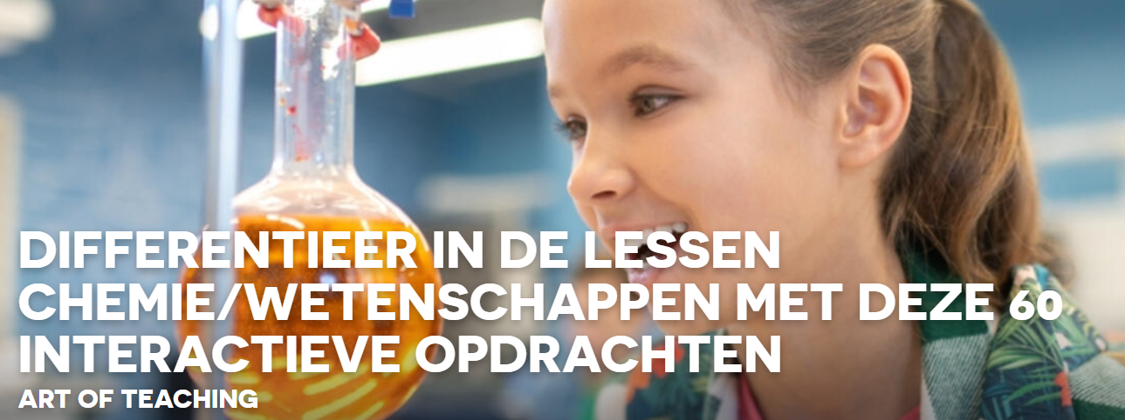
CT- interactives
Ilke

Slide 2
Ctinteractives : CT Interactives - Submicro (google.com)
btriangle (chemicalthinking.xyz)
Lab Interactive: Energy of Bond Formation (conceptual version) (concord.org)
submicro (chemicalthinking.xyz)
bondpol (chemicalthinking.xyz)
Vooral richten op chemische bindingen: onderscheid en wanneer atoom- en ionbinding

Slide 3

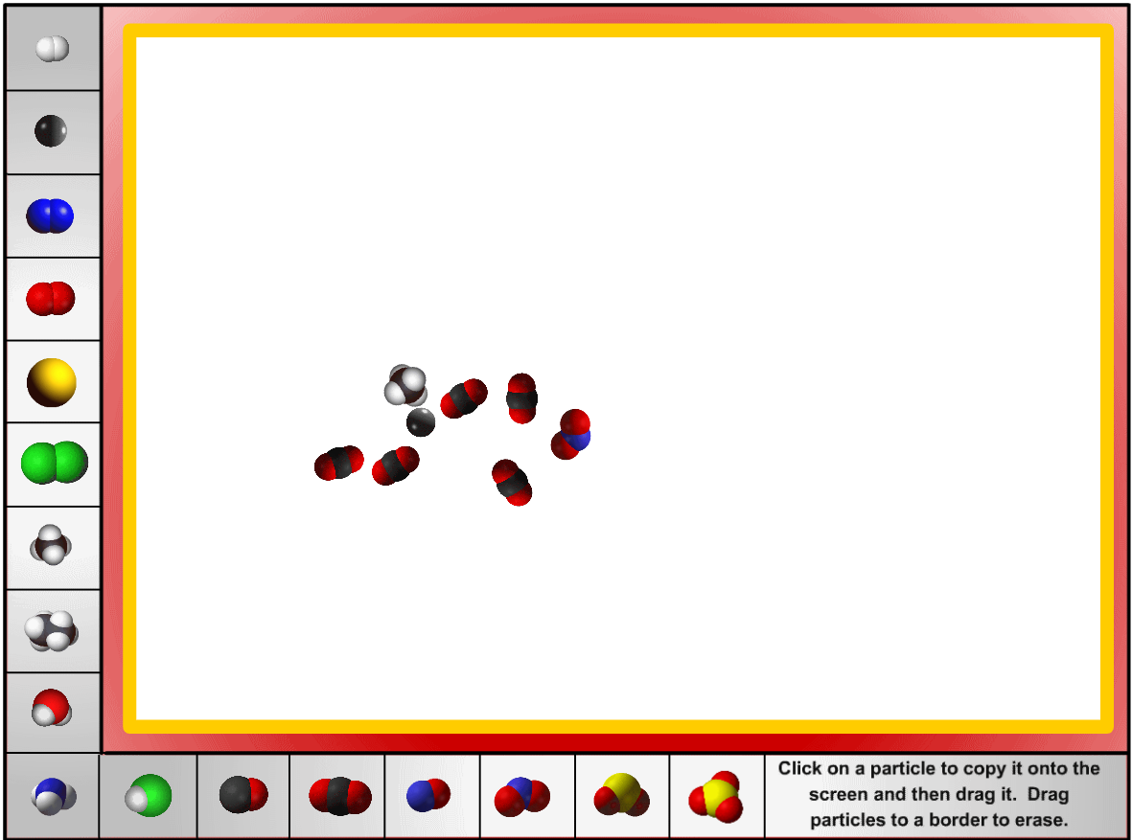
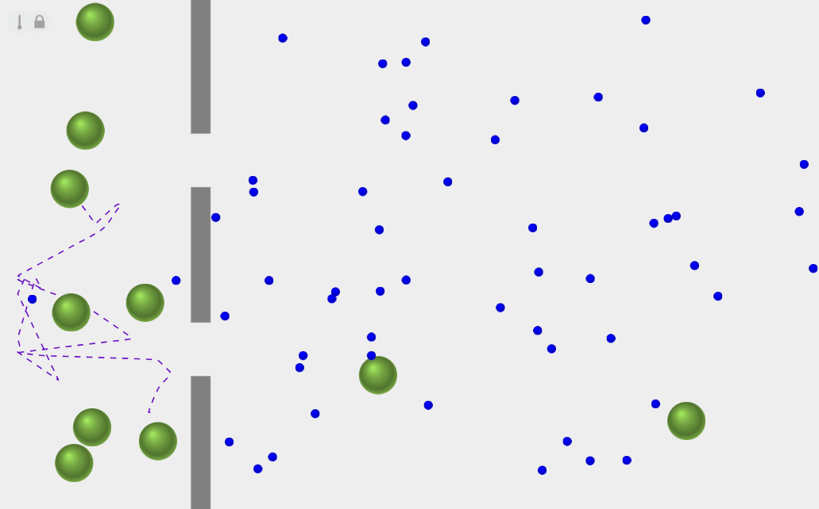
Mengsels – zuivere stoffen
tekenen
diffusie

Slide 4

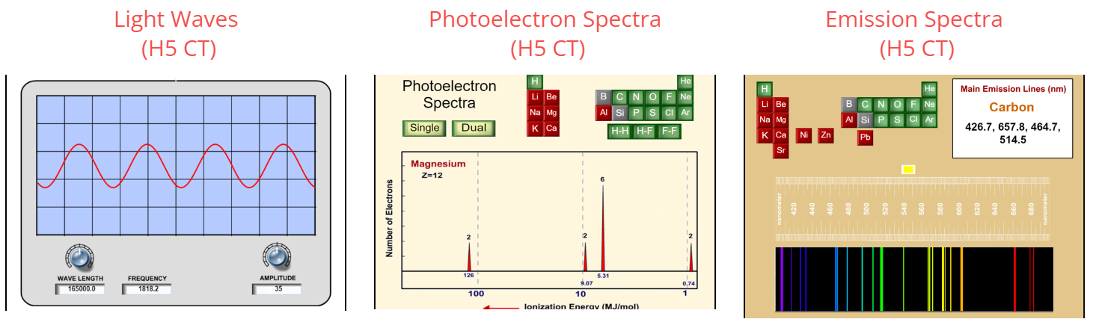
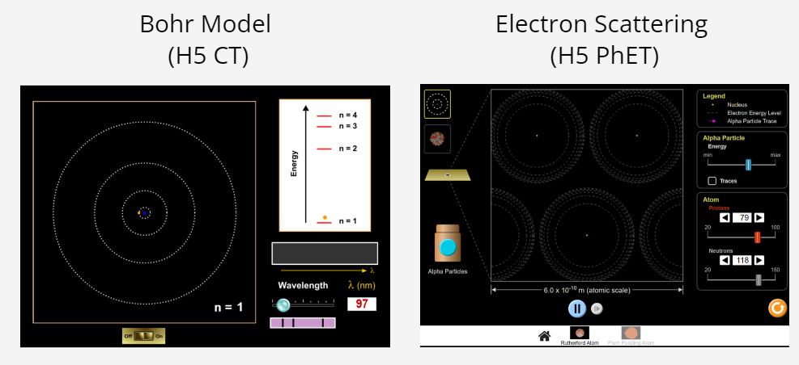

Slide 5

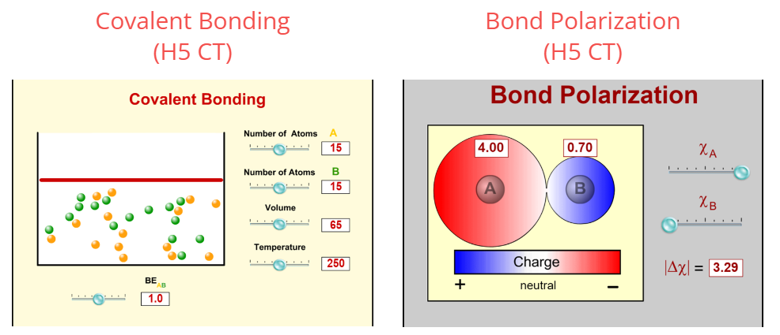
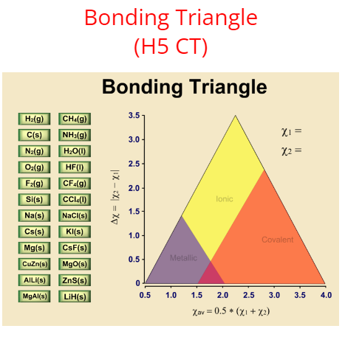
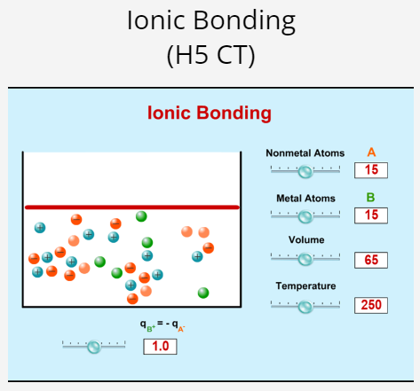

Slide 6


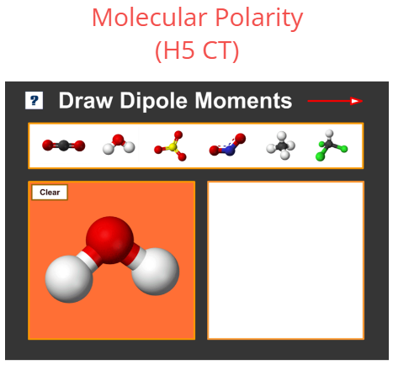
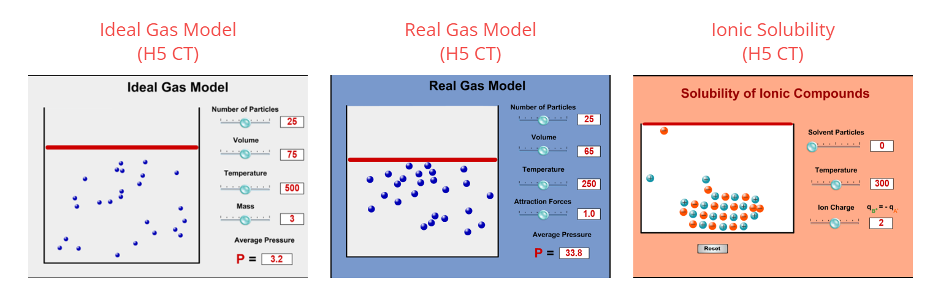
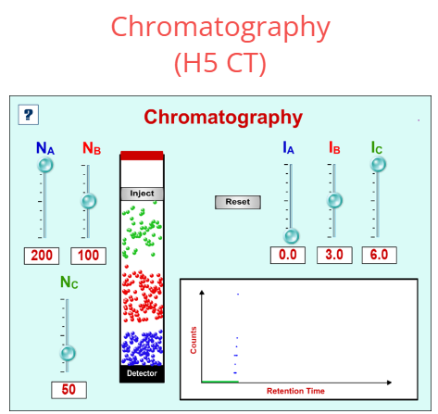
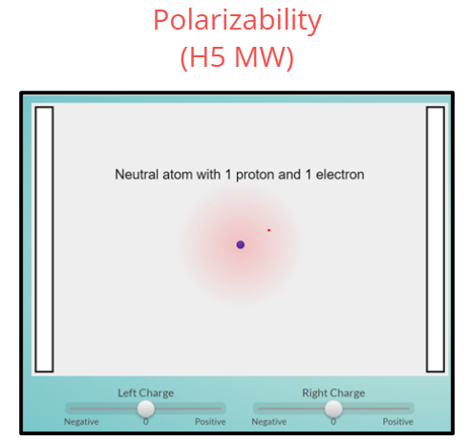

Slide 7

