Slide 1
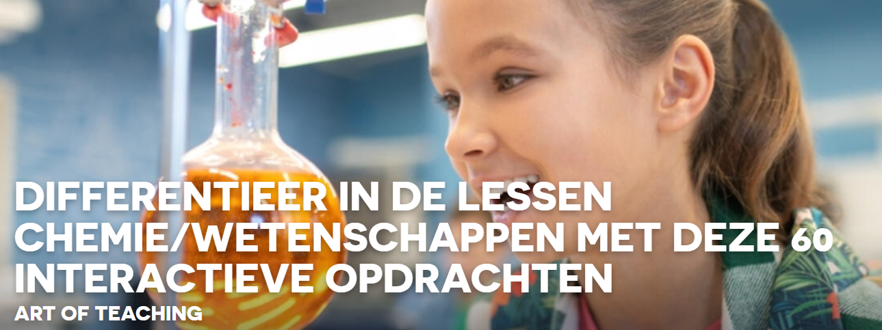
Begrippen voorstellen met youtube animaties
Hanne

Slide 2
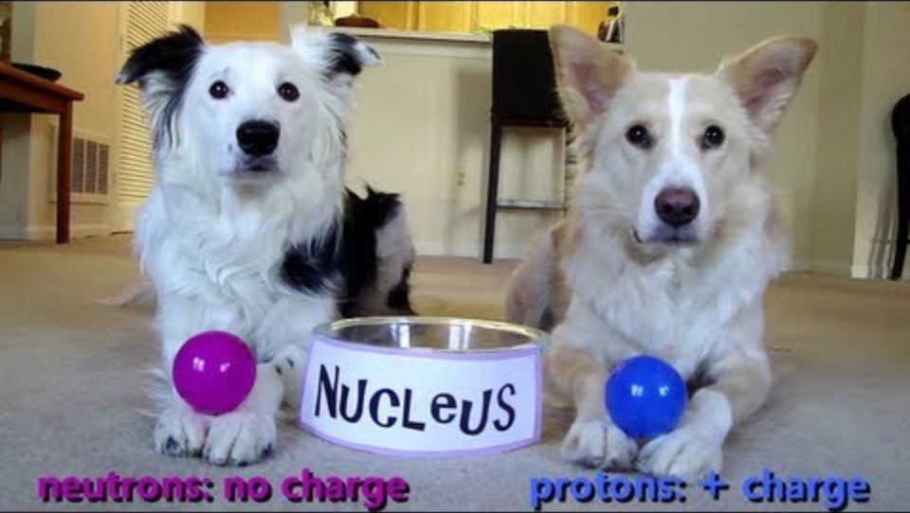
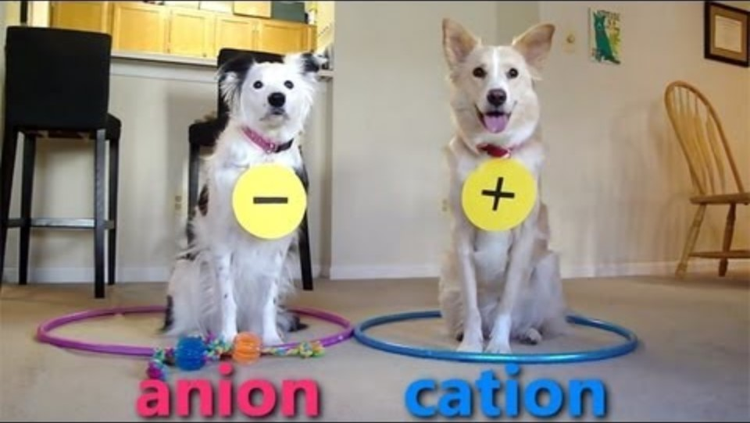
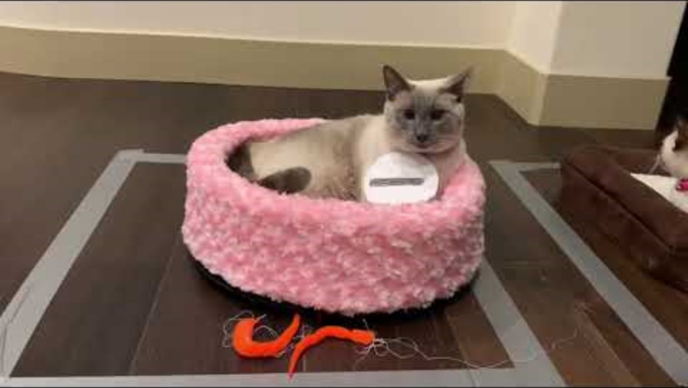
Dogs Teaching Chemistry - The Atom (youtube.com)
Dogs Teaching Chemistry - Chemical Bonds (youtube.com)
Cats Teach Science (youtube.com)

Slide 3
https://www.youtube.com/watch?v=jPaGOHwv7mQ&list=PL65159266CFC74682&pp=iAQB8AUB
LAB REGELS - Dua Lipa "New Rules" Parodie (youtube.com)
Lab Safety Video - YouTube

