Slide 1
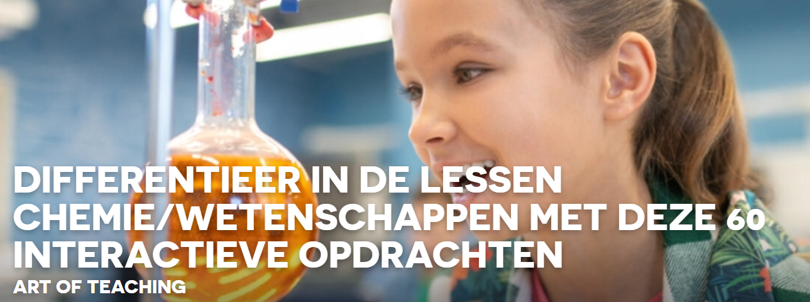
AR-modellen van organische stoffen: sofie

Slide 2
Chemistry ARMV on the App Store (apple.com) en ook
MARVLS AR Chemistry on the App Store (apple.com)
3D-Modelle – Chemie digital (chemie-digital.de) - IUPAC-nomenclatuur - Digitale chemie (chemie-digital.de) . + https://builder.molview.org/
Deze modellen gebruiken in een opdracht om structuren in te oefenen.
BioSIM - Augmented Reality - BioSIM
Molecules AR in de App Store (apple.com)
MolAR: moleculaire augmented reality (mtzgroup.github.io)
AR VR-moleculen editor in de App Store (apple.com)

Slide 3

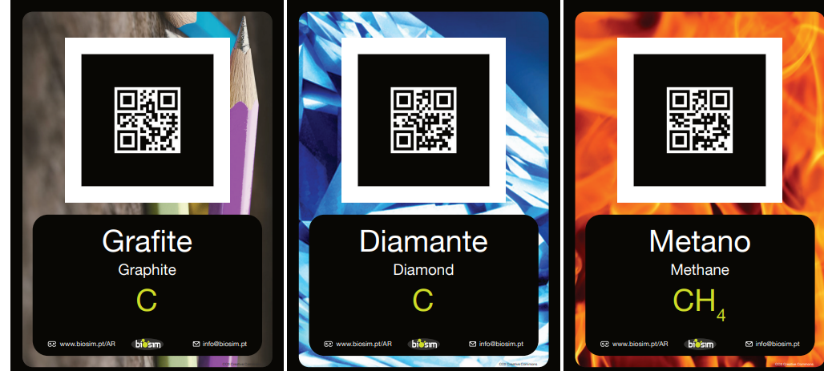
BioSIM - Augmented Reality - BioSIM

Slide 4
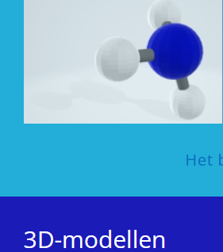
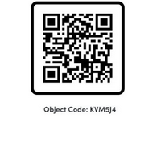
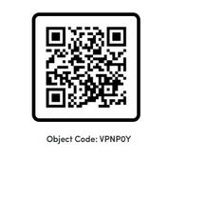
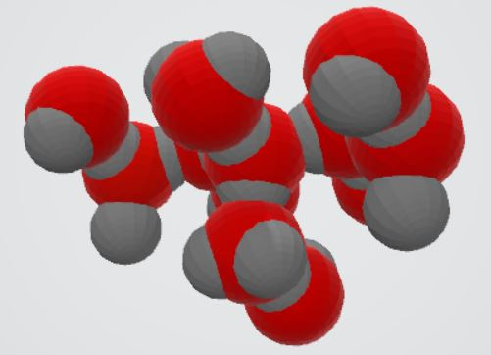
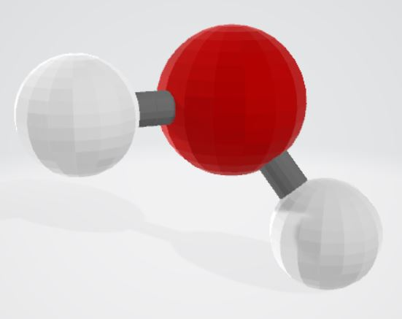
3D-Modelle – Chemie digital (chemie-digital.de)
IUPAC-Nomenklatur – Chemie digital (chemie-digital.de)

Slide 5
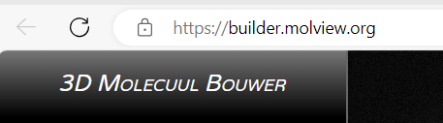
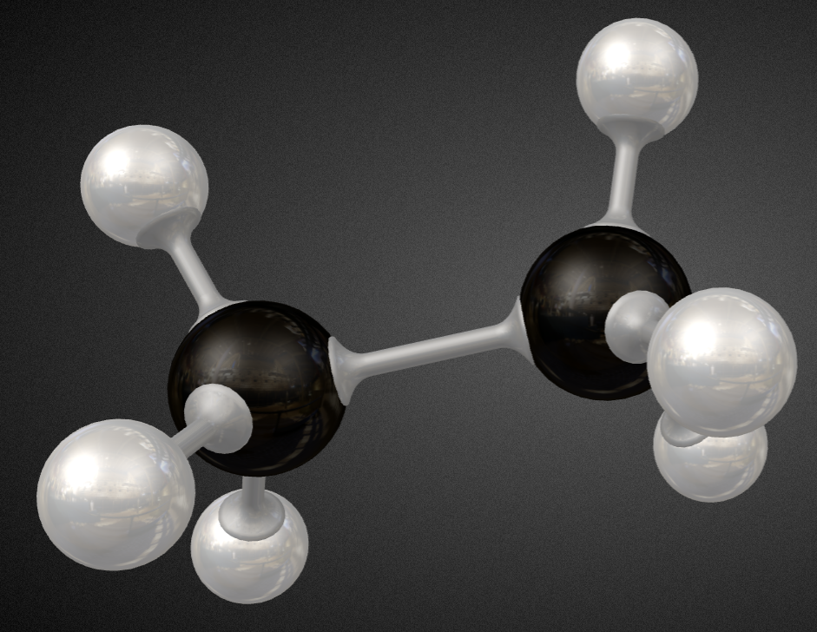

Slide 6
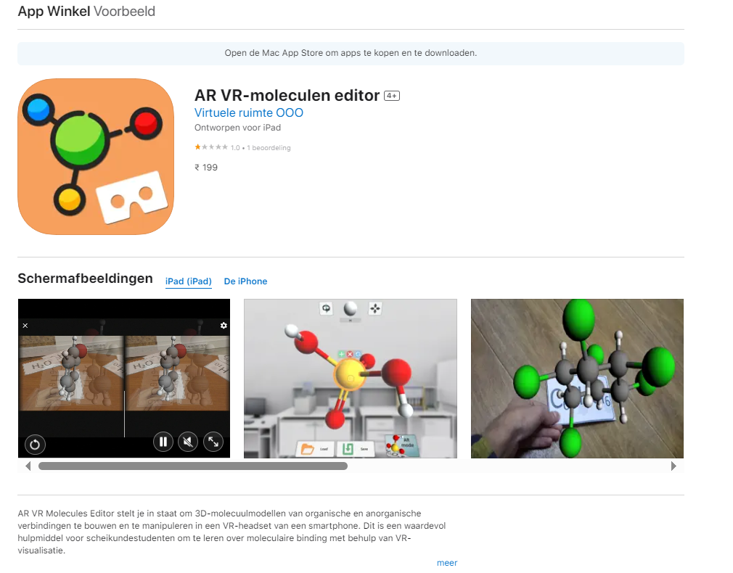
AR VR-moleculen editor in de App Store (apple.com)

Slide 7
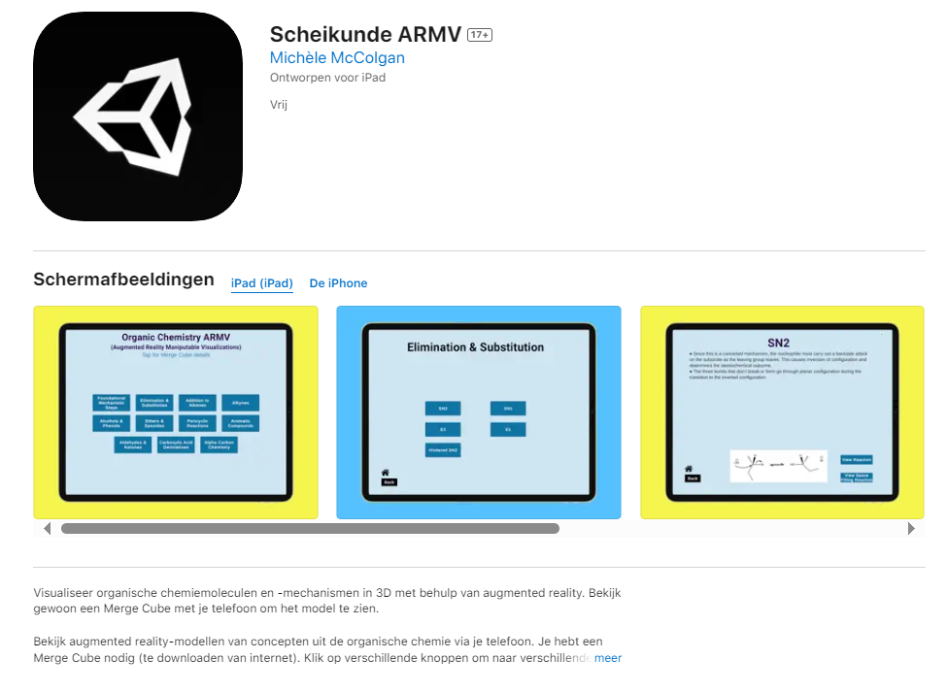
Chemistry ARMV in de App Store (apple.com)

Slide 8
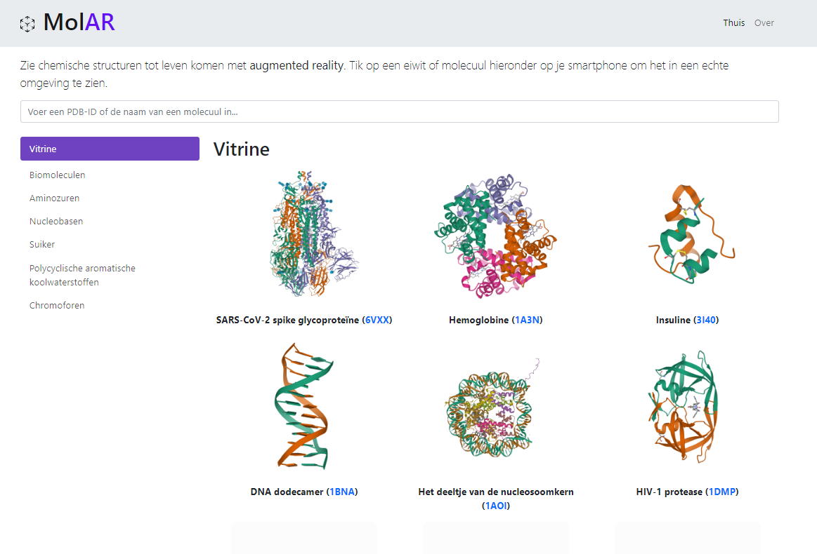
MolAR: moleculaire augmented reality (mtzgroup.github.io): zelf AR moleculen maken

